Slide 1

Software Engineering
Jona Mehmeti
Dennis Elmadhi
Enxhi Kadiu
Frenkli Bajrami
Gridi Kasemi

Slide 2
Agenda
Introduction
Project Aim & Overview
Project Structure
Architecture Decisions
Data Input
Presentation Title

Slide 3

Introduction
Welcome to the Budget Management Application Presentation. Today, we will explore an innovative solution designed to help individuals and businesses effectively manage their finances. By leveraging the power of technology, this application aims to simplify budget tracking and empower users to make informed financial decisions.

Slide 4
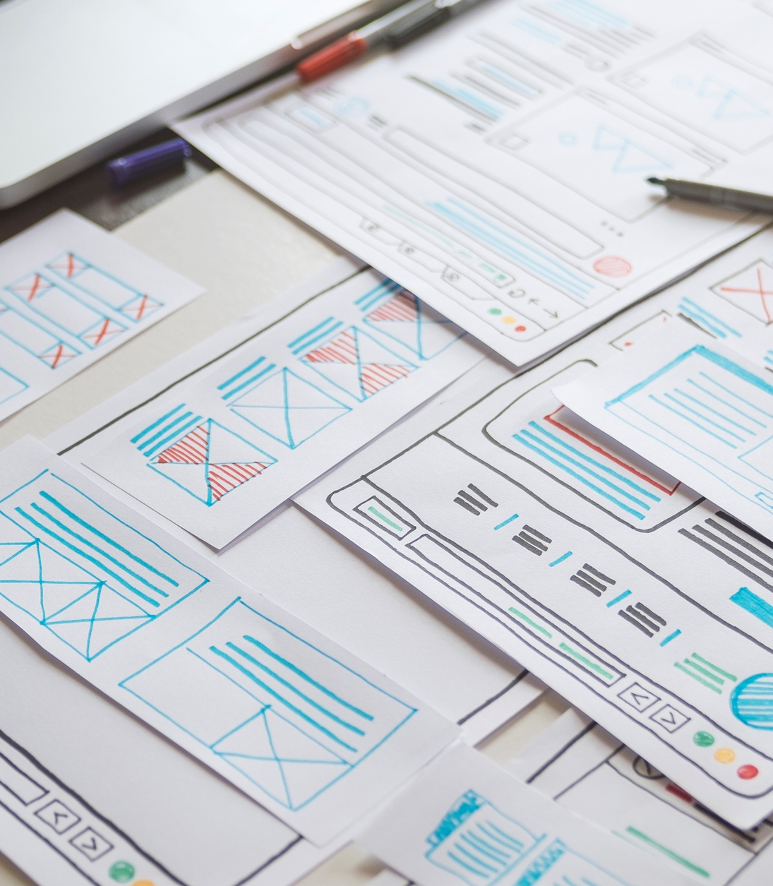
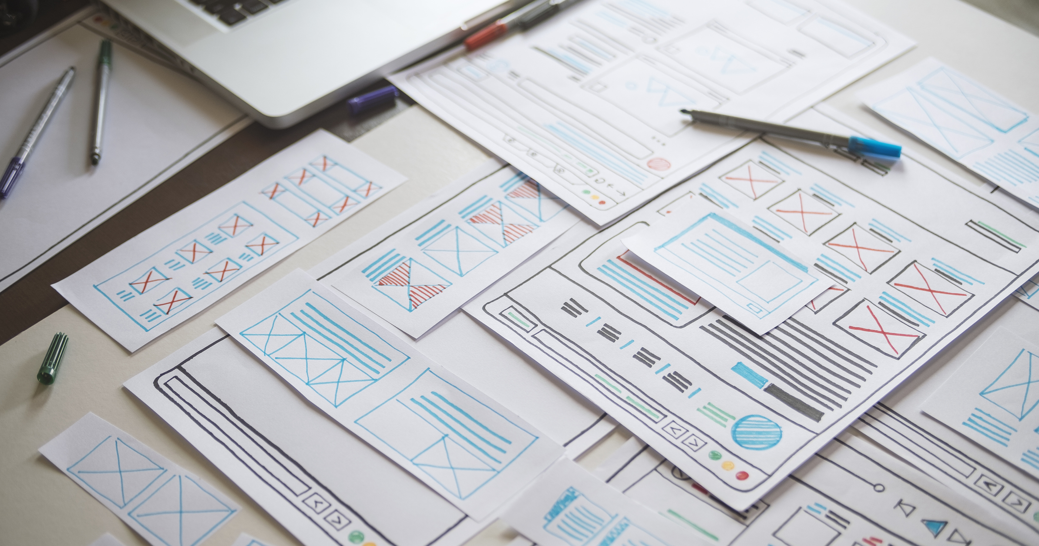
Project Aim & Overview

Slide 5
Our project revolves around developing a budget management application that caters to the needs of individuals, households, and small businesses. With a user-friendly interface and powerful features, our application aims to streamline the process of budget management, enabling users to gain better control over their finances.

Slide 6
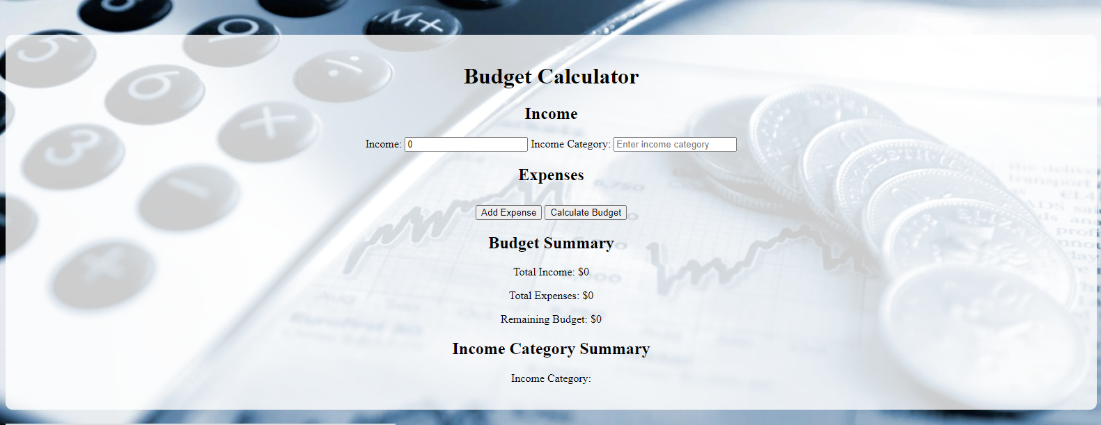

Project Aim & Overview
The primary objective of this project is to provide users with a comprehensive and efficient solution for budget management. By offering a range of features, such as income tracking, expense management, and budget calculations, our aim is to empower users to achieve their financial goals and lead a financially stable life.

Slide 7
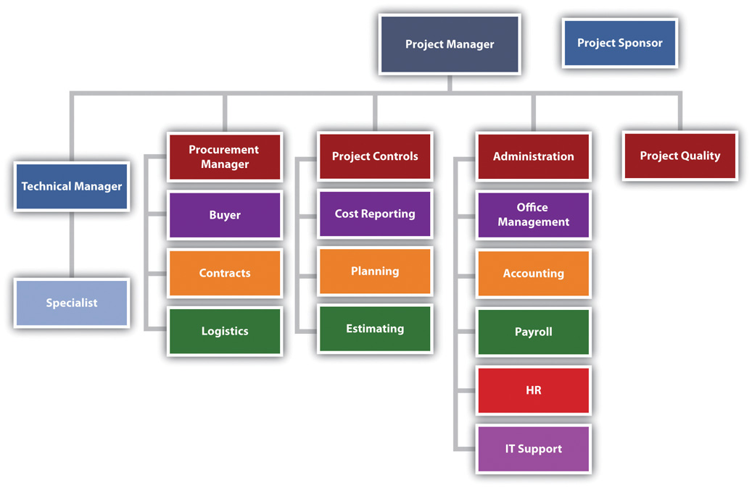
Project Structure
Our budget management application is structured into several key components. These include data input modules for income and expenses, a robust budget calculation engine, intuitive reporting and visualization tools, and seamless integration with GitHub authentication for secure user login. This modular structure ensures a cohesive and scalable application architecture

Slide 8



Data Input
Data Input: Income and Categories
Our application allows users to input their income information effortlessly. Users can specify various income categories to accurately track different sources of income. This feature ensures that users have a comprehensive overview of their earnings and facilitates better budget planning.
Data Input: Expense Management
Expense management is a crucial aspect of budget management. Our application simplifies this process by enabling users to add and categorize their expenses seamlessly. Users can easily track their spending habits, assign expenses to specific categories, and gain insights into their expenditure patterns.
Budget Calculation
Once income and expenses are entered, our application performs complex budget calculations to provide users with a clear overview of their financial situation. By analyzing the income and expense data, our algorithm generates accurate budget metrics, such as savings, available funds, and projected expenses, allowing users to make informed financial decisions.

Slide 9
During the development process, we made careful architectural decisions to ensure a robust and scalable application. Leveraging modern technologies, frameworks, and design patterns, we created a modular architecture that promotes maintainability, extensibility, and performance. These architectural decisions lay a solid foundation for future enhancements and improvements.
Architecture Decisions

Slide 10

GitHub Authentication
To ensure secure user login, we integrated GitHub authentication into our application. GitHub authentication offers a seamless and reliable login experience for users, leveraging the trusted authentication infrastructure of GitHub. This integration enhances user security and privacy, providing peace of mind while accessing the application.
This Photo by Unknown Author is licensed under CC BY

Slide 11
In conclusion, our budget management application is a powerful tool designed to simplify the process of financial management. By providing an intuitive user interface, robust budget calculations, insightful reporting, and secure authentication, we aim to empower users to take control of their finances and achieve financial well-being.
Conclusion

Slide 12


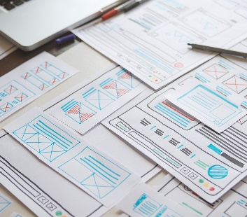

Thank you

